Slide 1
2016 VVV Reunion
Portraits

Slide 2
VVV President, Darren Welch and daughter Anna.

Slide 3
Reunion host, Chad Bugos with Brooke Bugos, Austin Bugos and Tori Krager

Slide 4
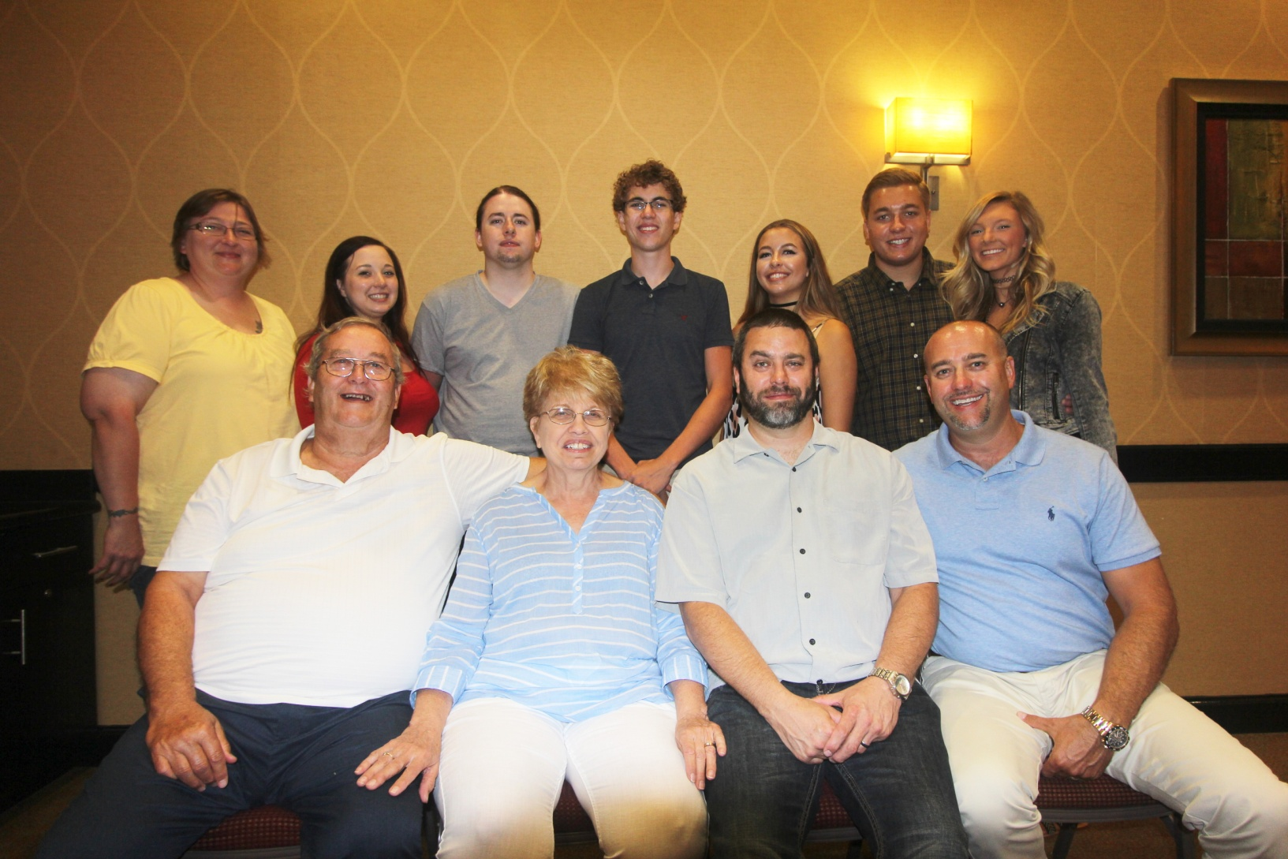
Back row: Michelle Bugos, Caitlyn Dawson, Tyler Bugos, Dylan Bugos, Brooke Bugos,
Austin Bugos, and Tori Karger
Front row: Paul Bugos, Connie Bugos, Brad Bugos and Chad Bugos

Slide 5
Patti Vaughters, Ray Vaughters and Dorothy Keeton

Slide 6
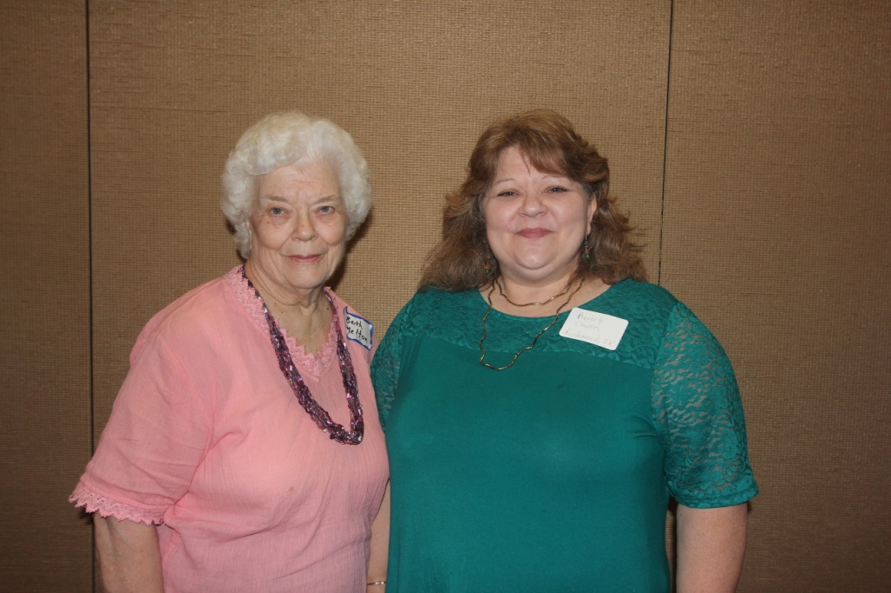
Kacie Tatum with Karen Vaughters Tatum
Beth Melton and Beverly Cowan

Slide 7
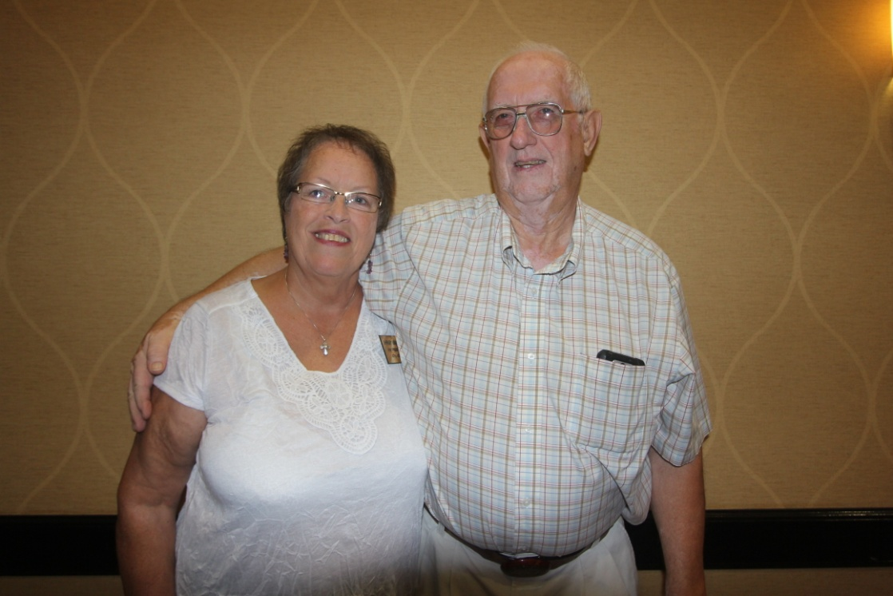
Linda Vawter, Jason Vawter and Lilah Vawter
Shirley and Gerald Beasley

Slide 8
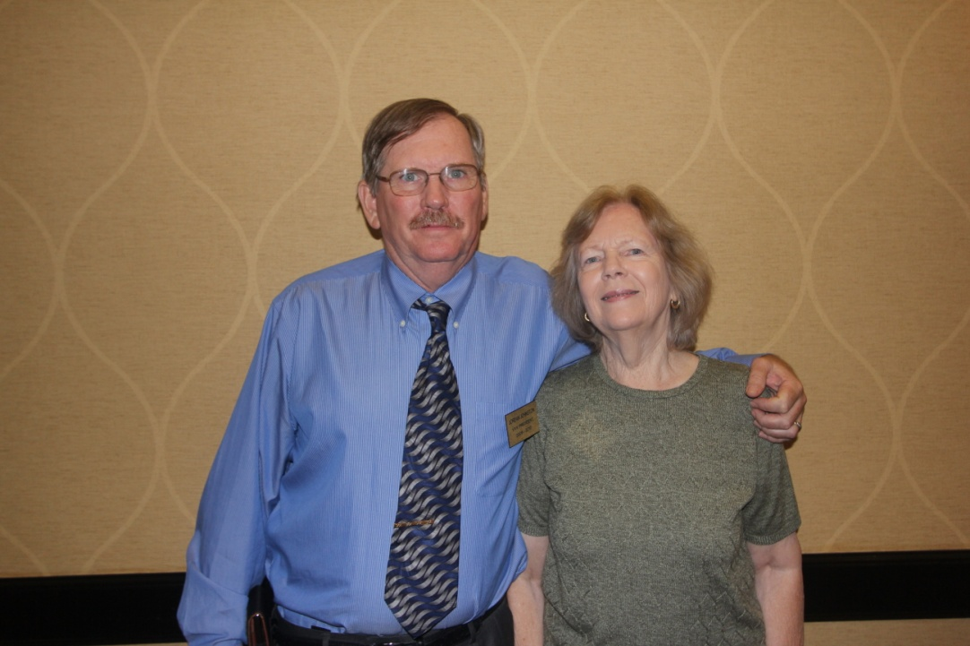
Michael and Brenda McNary
Jordan Johnston and Patricia Renton

Slide 9
Robert L Vawter (II), Robert L Vawter and Robert L Vawter
r

Slide 10
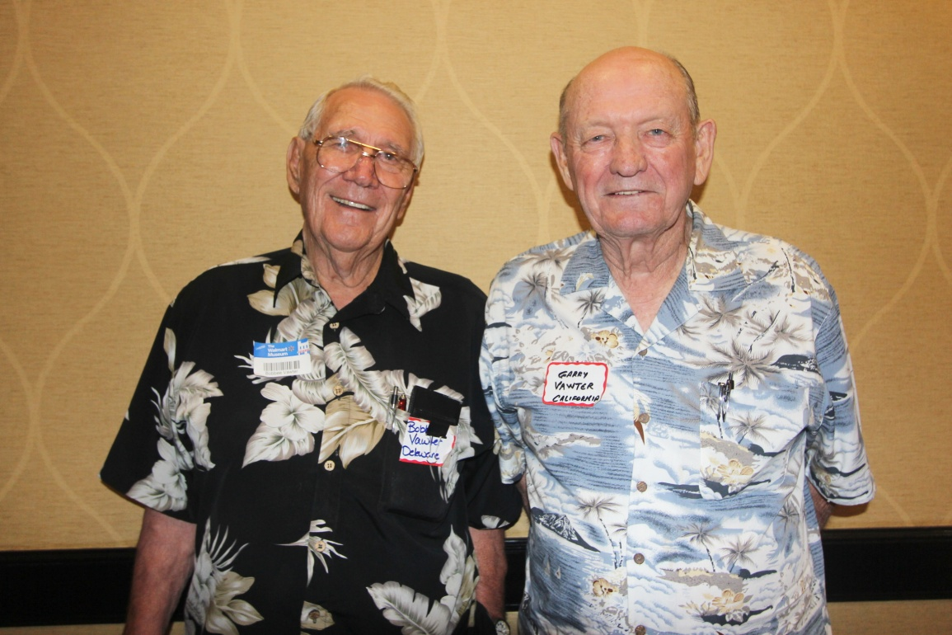
Robert L Vawter and Garry Vawter
Robert L Vawter II and Linda Vawter

Slide 11
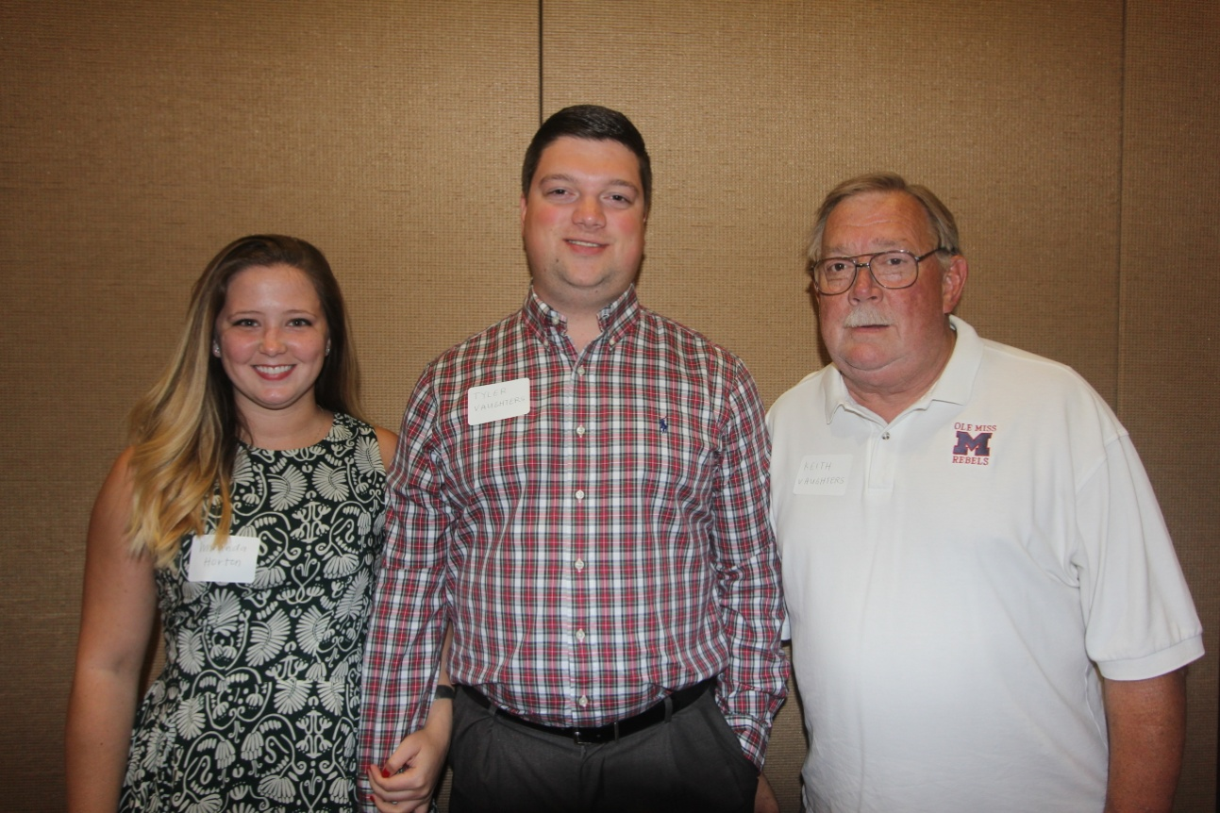
John Allen and sister Nancy Allen Evans
Miranda Horton, Tyler Vaughters, Keith Vaughters

Slide 12
Back row: Jackie Smith, Margie Hudson, Brandon Smith, Martha Hudson
Front row: Ryan Shipley, Ian Smith and Corrine Smith

Slide 13
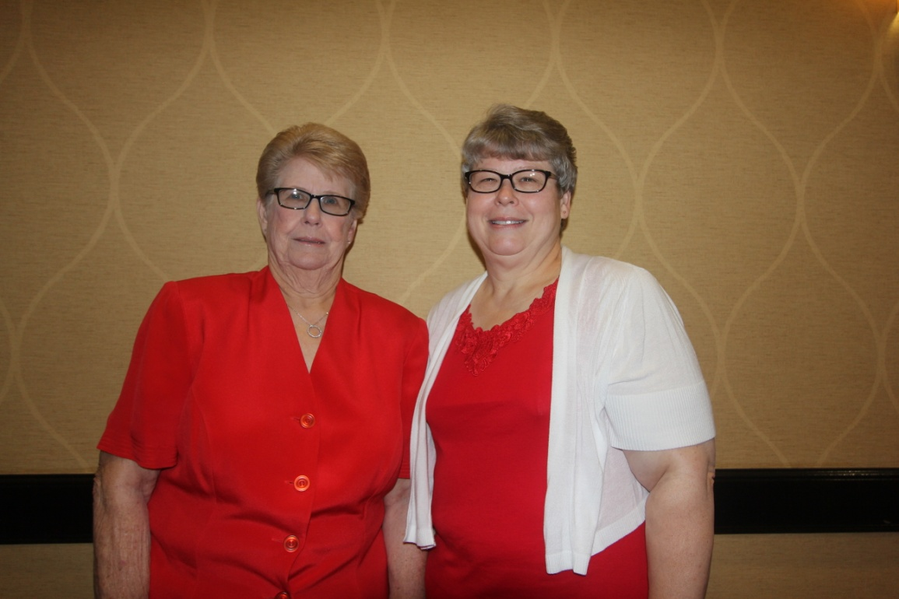
Sybil and Harold Lansdale
Sue Vawter
and Renae Vawter Chaviers

Slide 14
Michelle, Reba and Mike Alexander

Slide 15
Sheri Collie, Marjorie Shafer, Mary Wilhelm and Charles Wilhelm

Slide 16
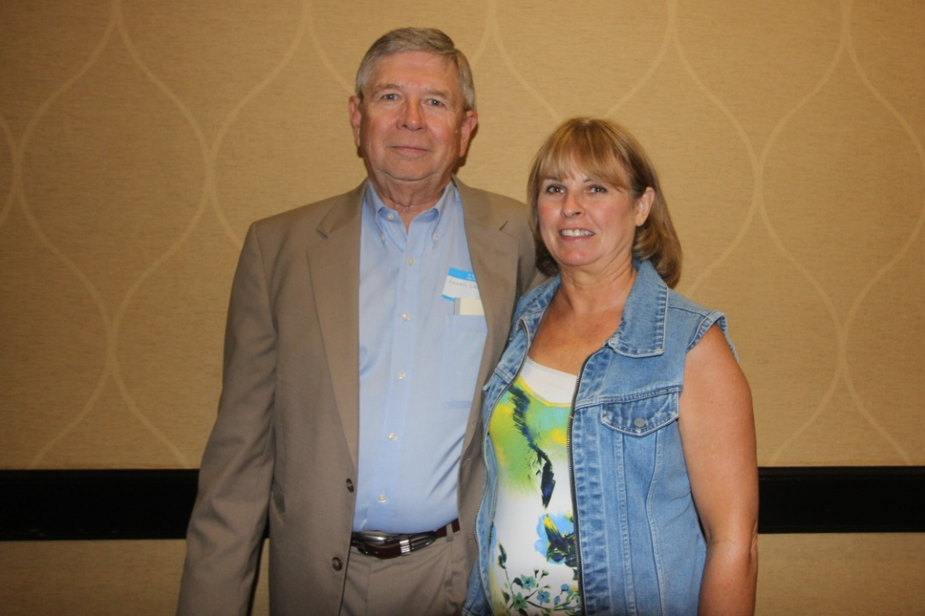
Lois Shuck and Nancy Southard
Lowell and Angela Vaughters

Slide 17
Lowell and Doris Knutson Lori and Randy Sipe

Slide 18
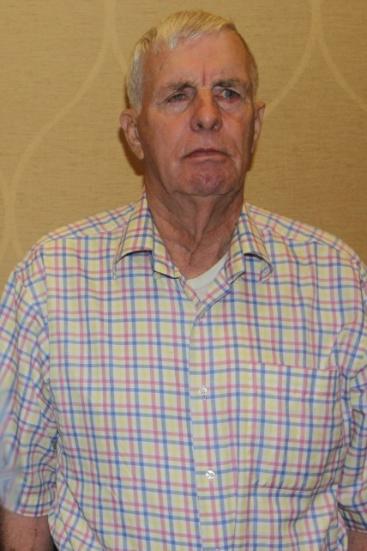
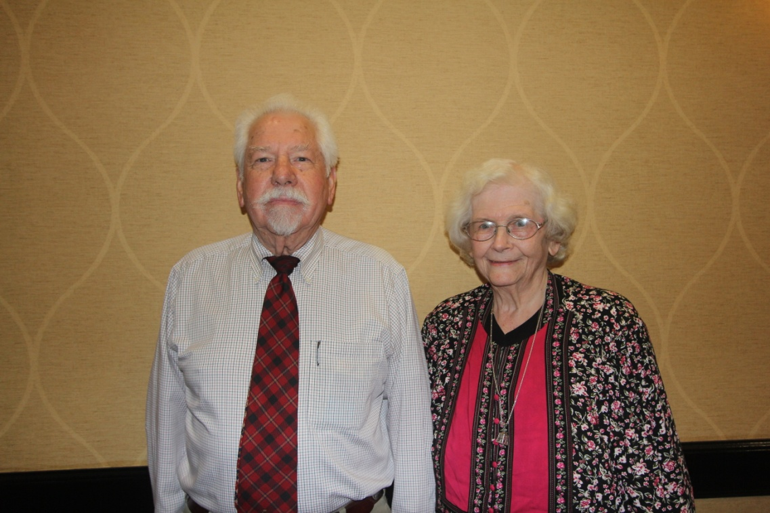
Ellen Wicker Cummings and Fred Wicker
George Wicker
Ken and Norma Wicker

Slide 19
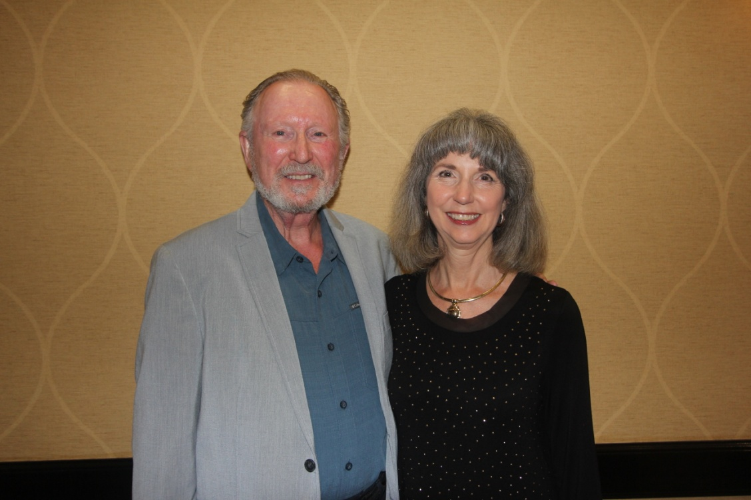
Tom and Wilma Hood
B. Ray and Sharon Mize

Slide 20
Back row: Mark Slater, David Slater, Morris Slater, Jr, and Wayne Slater
Front row: Ellen Slater, Emily Slater and Ann Slater

Slide 21
Ellen Slater, Morris Slater, Jr., Marjorie Shafer, Doris Knutsen,
Wilma Hood, Terry Slater
In back, Lowell Knutsen, Tom Hood and Larry Slater

Slide 22
Many thanks
To Michael McNary
For the photographs.

